Slide 1

Bringing New Platforms to React Native
Eric Rozell
@ericrozell, @ReactWindows

Slide 2
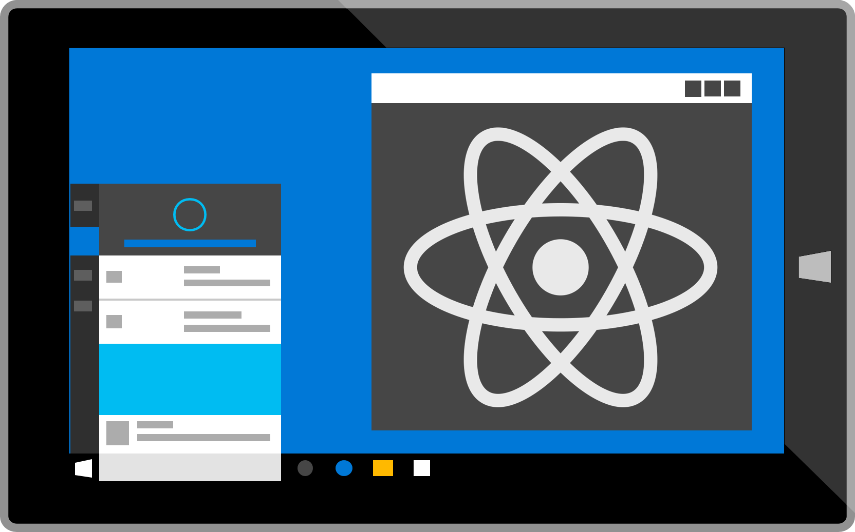
React Native for Universal Windows Platform
Notes:
Over the past 8 months, we have been building the core native libraries for React Native on the Universal Windows Platform at Microsoft.
We started this effort after spending a few months working on a personal assistant app for the visually impaired, called Soundscape. This was by no means a thin client, with a significant amount of business logic layered on top of the Bing and other Web services we were consuming.
We were building the app for iOS, Android, and WP10 in their native languages, and, as you can imagine, we encountered cases where we had to fix the same bug three times, had to test three times for each feature, and had many cases of slight differences in behavior due to different implementation approaches.
While looking for a cross-platform solution, we also had a number of partners outside Microsoft who were asking about React Native for Windows, so it seemed like a good time to start hacking.

Slide 3
React
React Native
iOS
Android
UWP
…
Web
Notes:
But I‘m not here to just talk about react-native-windows.
React Native is an extremely democratic platform, and there is potential to apply React Native to any platform that can host a JavaScript runtime.

Slide 4
React Native Platform Efforts
iOS / Android - https://github.com/facebook/react-native
Windows 10 - https://github.com/ReactWindows/react-native-windows
Web - https://github.com/necolas/react-native-web
Ubuntu - https://github.com/CanonicalLtd/react-native
macOS - https://github.com/ptmt/react-native-macos
tvOS - https://github.com/douglowder/react-native-appletv
WinJS - https://github.com/axsy-dev/react-native-winjs
Notes:
As you can see, there are already quite a number of reasonable efforts towards reactifying other platforms.
I’m hoping to share with you some key takeaways and designs from our experience of building react-native-windows.

Slide 5




Why build React Native platform extensions?

Slide 6
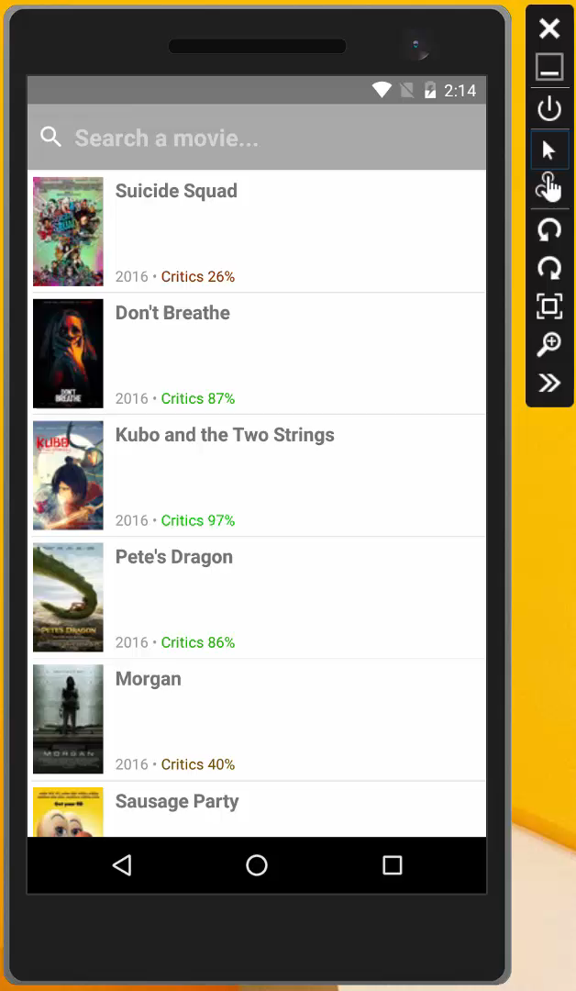
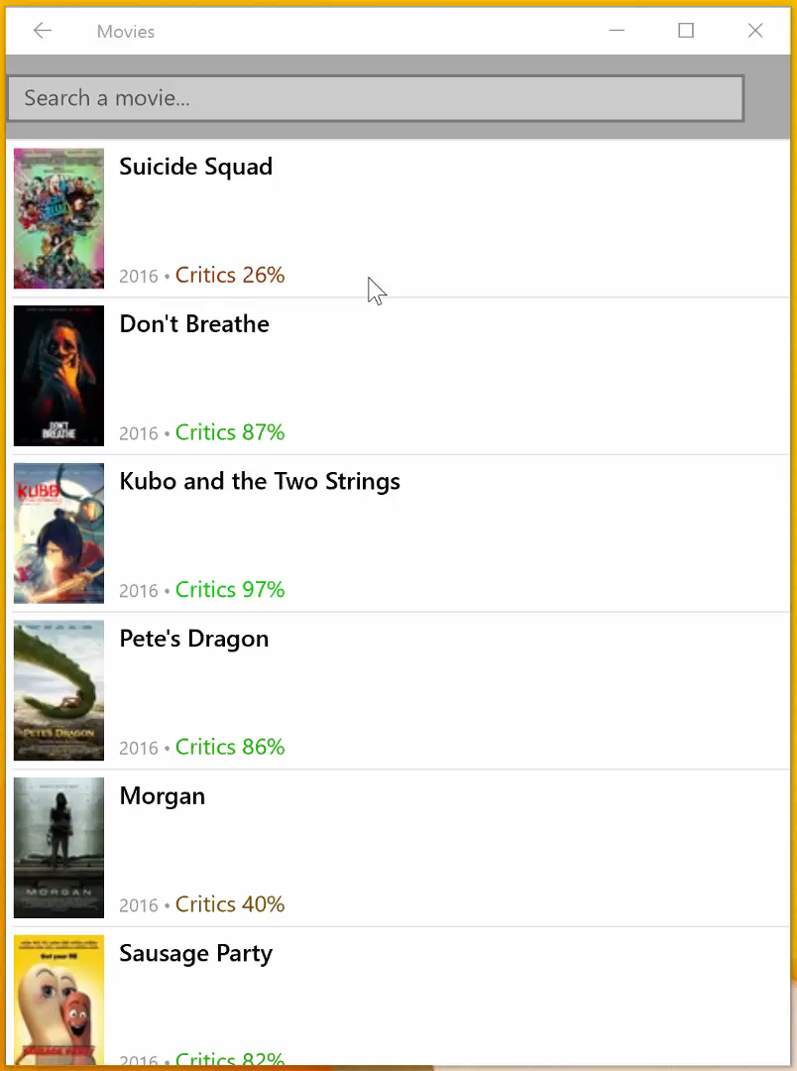
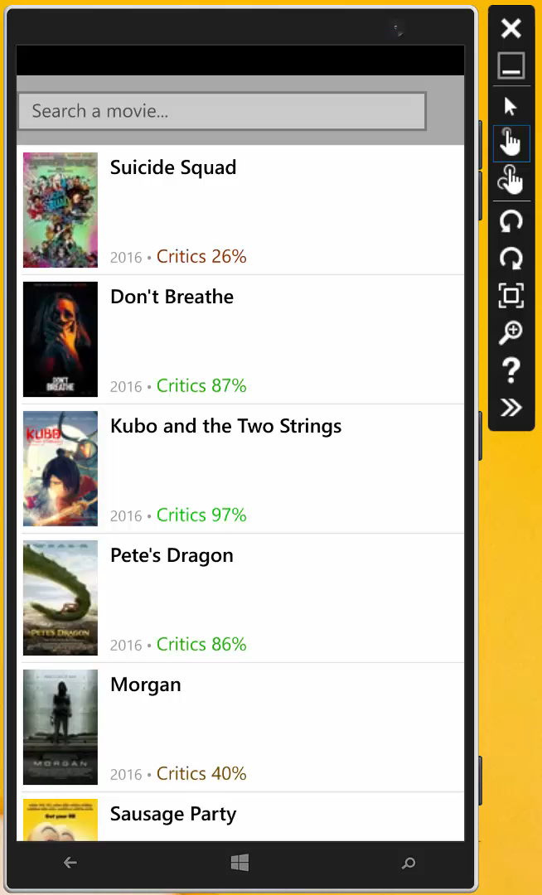

Slide 7
Key Takeaways
React Native platform extensions are not about parity.
Basic structure of a React Native platform extension.
Start prototyping your app on new
platforms as soon as possible.

Slide 8
Key Takeaways
React Native platform extensions are not about parity.
Basic structure of a React Native platform extension.
Start prototyping your app on new
platforms as soon as possible.

Slide 9
What is parity anyway?
Third Party Parity
Tools Parity
Component Parity
Core Parity
Notes:
Generally, when asked if we have platform parity, we start by talking about core parity.
By core parity, I basically mean we have a functioning React bridge, that allows messages to be exchanged between React and the native space.
Threading model is in place
Basic module polyfills like XmlHttpRequest and Timers are functional.
We have a functioning UIManager to manage the native view hierarchy.
This is what I think of as a bare minimum native implementation of a React Native platform extension.
The next level of parity is component parity. This means that the core components that users expect, like Image, Text, TextInput, ScrollView, ListView, etc. are available.
I think generally when people ask about parity, they are also talking about these components.
The next level is tools parity, which some might take for granted but is very important. Does your platform extension support remote debugging, live and hot module reloading, and hook nicely into the react-native CLI?
If not, you’re going to have a hard time getting existing React developers to jump into building for your platform.
Lastly, the part that no RN platform extension team can possibly scale, is third party parity.
There are hundreds of native modules that have been built for iOS and Android. Some of these will totally make sense to port immediately to your platform, but for the long-tail of these modules, you’re just going to have to wait for enough developers to file issues or make requests to the project maintainer to start an effort for your platform.

Slide 10
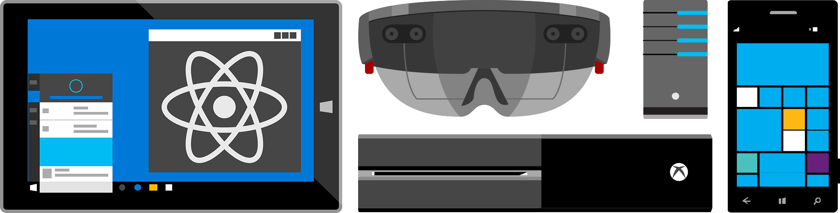
Code sharing is important but…

Slide 11
React Native as a Horizontal Platform
“Write once, run anywhere”
“Learn once, write anywhere”

Slide 12
Key Takeaways
React Native platform extensions are not about parity.
Basic structure of a React Native platform extension.
Start prototyping your app on new
platforms as soon as possible.

Slide 13
React Native Platform Extension Architecture
JavaScript engine
Thread queues
Native bridge and module registry
UIManager module and core components
Flexbox and styling
Touch and user input handling
JavaScript customization
Developer support and CLI

Slide 14
UI Thread
Platform-Specific Views
Scrolling
Native Events
Layout /
Native Module Thread
Flexbox
Native APIs
JS Thread
User Logic

Slide 15
iOS
Android
Windows
UI Thread
UI Thread
UI Thread
Layout Thread
JS Thread
JS Thread
JS Thread
Native Module Thread
Native Module Thread
Layout /
Native Module Thread
Native Module Thread
…

Slide 16
React Native Platform Extension Architecture
JavaScript engine
Thread queues
Native bridge and module registry
UIManager module and core components
Flexbox and styling
Touch and user input handling
JavaScript customization
Developer support and CLI

Slide 17
JavaScript Customization
import {Platform} from 'react-native';
...
if (Platform.OS === 'ios') {
...
} else {
// start Android assumption here
...
}

Slide 18
node-haste to the rescue!
node-haste is a dependency management system for static resources for node.js. It provides the ability to statically resolve JavaScript module dependencies both for node module resolution and Facebook's haste module system.

Slide 19
How node-haste works
var Foo = require('foo');
/**
* Copyright (c) 2016-present, Eric Rozell
*
* @providesModule foo
*/
node_modules/foo/index.js

Slide 20
Platform overrides with node-haste
node_modules
foo
index.android.js
index.js
index.native.js
index.windows.js

Slide 21
React Native Platform Extension Architecture
JavaScript engine
Thread queues
Native bridge and module registry
UIManager module and core components
Flexbox and styling
Touch and user input handling
JavaScript customization
Developer support and CLI

Slide 22
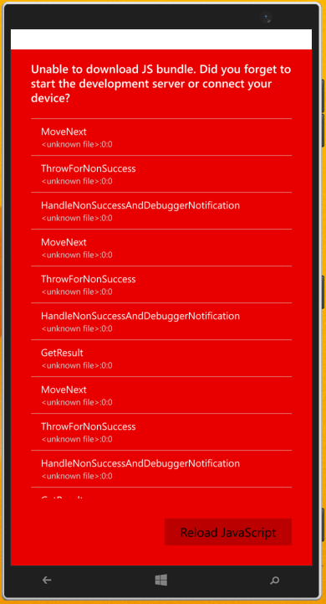
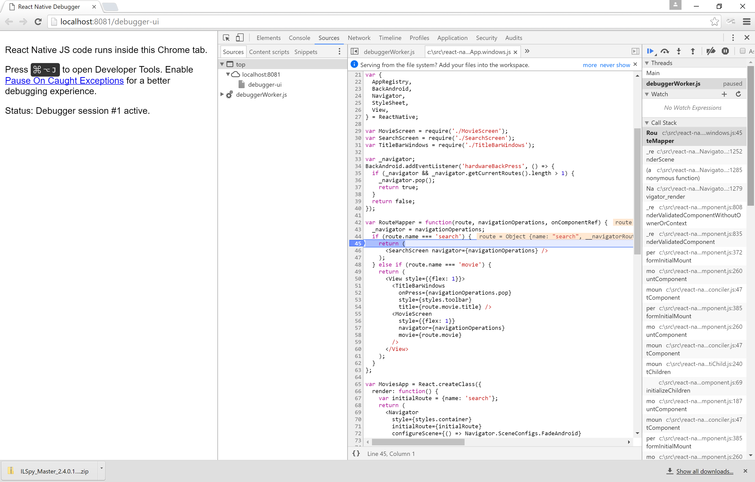

Slide 23
React Native CLI Architecture
React Native CLI includes tools for…
Initializing projects
Capturing logs
Build and run
Bundle
Link
Upgrade
Etc.

Slide 24

React Native CLI Architecture
(now just react-native-cli)

Slide 25
React Native CLI Architecture
Global CLI - rnpm-plugin-windows
Acts as version selector for react-native-windows package
Exposes `windows` command, proxies to generator in react-native-windows package
Local CLI - react-native-windows
Exposes platform-specific command plugins through package.json (e.g., `run-windows`)

Slide 26

c:\src>
c:\src>
c:\src>
c:\src\myapp>
c:\src\myapp>
c:\src\myapp>
npm i –g react-native-cli
react-native init myapp
cd myapp
npm i --save-dev rnpm-plugin-windows
react-native windows
react-native run-windows

Slide 27
Why operate as a React Native plugin?
Scaling issues for single GitHub community
Control release cadence for your platform
Time to create react-native-ios and react-native-android?

Slide 28
Key Takeaways
React Native platform extensions are not about parity.
Basic structure of a React Native platform extension.
Start prototyping your app on new
platforms as soon as possible.

Slide 29

If you build it they will come…

Slide 30
If you build it they will come…

Slide 31

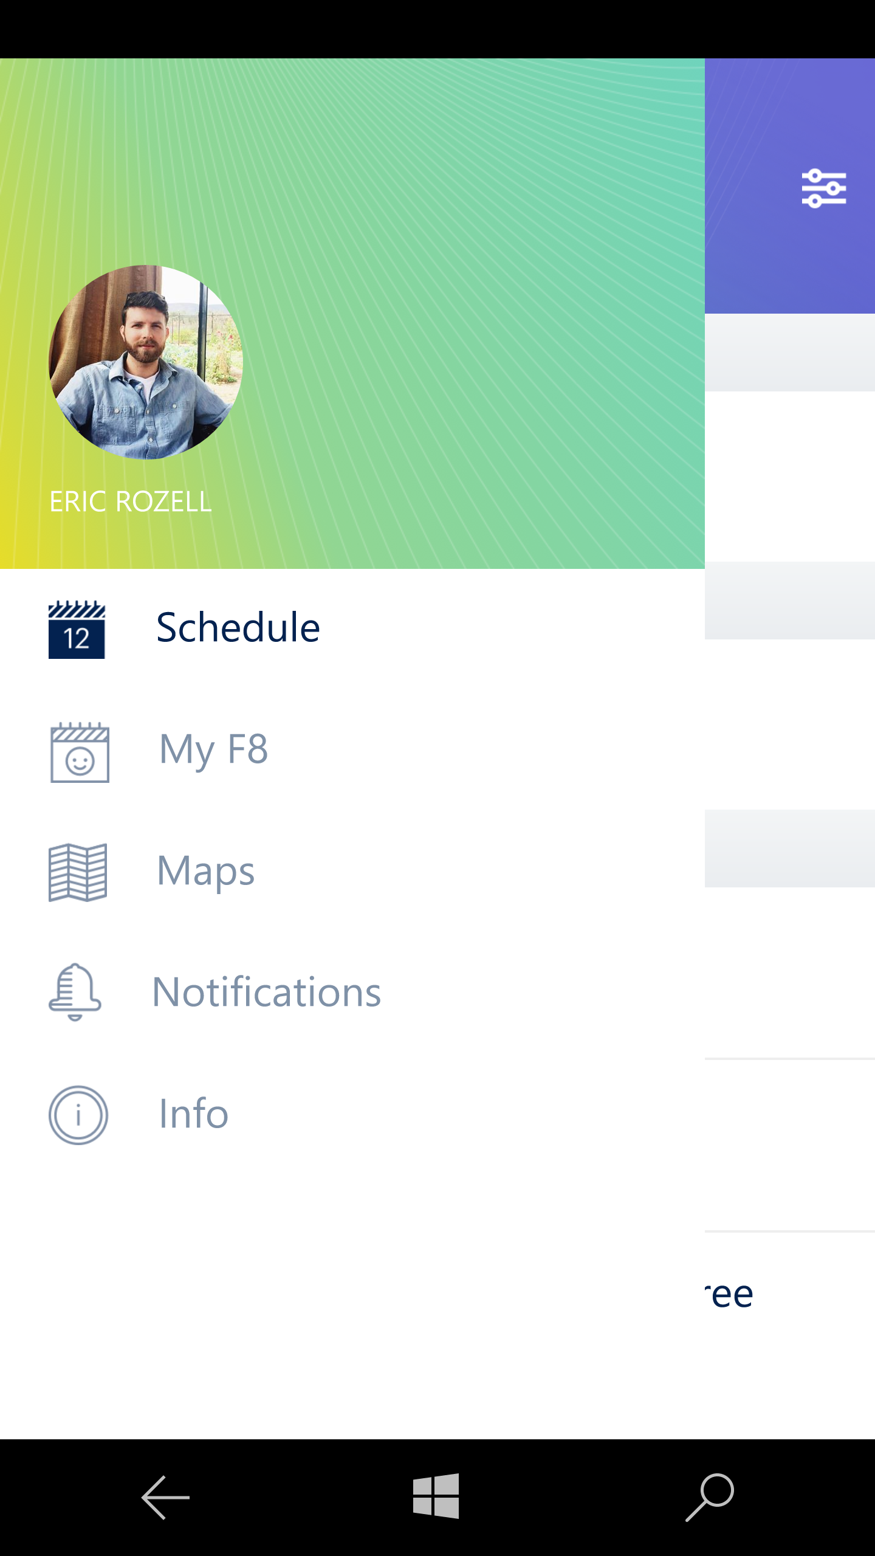
F8 Developer Conference App

Slide 32
Key Takeaways
React Native platform extensions are not about parity.
Basic structure of a React Native platform extension.
Start prototyping your app on new
platforms as soon as possible.

Slide 33
Thank you!
Eric Rozell
@ericrozell, @ReactWindows

